Slide 1
AGL Spec Development Training
March 9, 2015
Walt Miner – Linux Foundation
Phil Rutten – Jaguar Land Rover

Slide 2
Agenda
Introduction to DOORS NG
Updating DPRs

Slide 3
Introduction to DOORS NG

Slide 4
Introduction to DOORS NG
Training class for DOORS NG was held at All Member Meeting
Training slides available at https://wiki.automotivelinux.org/_media/agl_doors_ng_training_02222015.pdf

Slide 5
DOORS Next Generation (NG)
DOORS NG is very different from DOORS 9.x
DOORS NG:
has better collaboration capabilities than DOORS 9.x
has a better concept of sharing unique requirements, use cases, etc. (artifacts) between systems/projects
uses JavaScript rather than DOORS eXtension Language (DXL) for customization
However:
Numerous DOORS 9.x features are currently not supported in DOORS NG

Slide 6
Concept Mapping for DOORS Users
DOORS 9.x | DOORS NG
Database | Project Area
Projects/Folders | Folders
Modules | Virtual Modules / Folders
Objects | Artifacts
 | Artifact Types (Global) NEW
Attributes | Artifact Attributes (Global)
Attribute Types | Attribute Data Types (Global)
Views (Public, Private) | Views (Public, Private, Global)
Filters | Filters (Global)
Suspicious Links | Suspicion Profiles (Global)
OLEs | Embedded Graphics (bmp, png, etc)
Link Modules | Relationship Types (Link Types)
LinkSets | Preferred Relationships
Access Rights | Roles & Permissions
DXL | JavaScript (4.0.6)

Slide 7
Concept Mapping for DOORS Users
DOORS 9.x | DOORS NG
Database | Project Area
Projects/Folders | Folders
Modules | Virtual Modules / Folders
Objects | Artifacts
 | Artifact Types (Global) NEW
Attributes | Artifact Attributes (Global)
Attribute Types | Attribute Data Types (Global)
Views (Public, Private) | Views (Public, Private, Global)
Filters | Filters (Global)
Suspicious Links | Suspicion Profiles (Global)
OLEs | Embedded Graphics (bmp, png, etc)
Link Modules | Relationship Types (Link Types)
LinkSets | Preferred Relationships
Access Rights | Roles & Permissions
DXL | JavaScript (4.0.6)
Artifacts are the key concept in
DOORS NG

Slide 8
New for DOORS NG Users
DOORS 9.x | DOORS NG
 | Collections (Personal/Release)
 | Tags
 | Templates (more formal)
With an add-ons | Use Cases, UML, Storyboards

Slide 9
DOORS NG Artifacts
Artifact is a general term for an object in a repository.
Can manage artifacts in projects and folders
Can use tags to filter groups of artifacts for a specific purpose.
Artifacts can be of various types, which have customizable attributes and data types.
Artifact consists of
Content
Attributes (dependent on Attribute Type)
Artifact Types mainly used in AGL
Heading
Information
AGL Requirement Type (derived from System Requirement)

Slide 10
DOORS NG Artifacts
Heading
Works like a standard word processor heading
Content is the Heading Name
Numbering is determined by DOORS NG
Information
These sections are informational and do not contain requirements.
No attributes other than Status (see next slide)

Slide 11
AGL Requirement Type Attributes
Attribute | Data Type | Possible Values
Requirement Title | String
Function | Function | HMI Layer App Framework Layer Automotive Middleware OSS Layer Kernel/Driver Non-Functional Requirements
SR ID | String
Owner | User
Status | Enum | Draft Under Review Approved Rejected Deprecated
Priority | Enum | P1 – Mandatory P2 – Optional P3 - Information

Slide 12
Mapping From Current Spec (0.82)
Spec Field | DOORS NG Attribute | DOORS NG Value
ID | SR ID | WRT.1
Name | Requirement Title | Lifecycle
Category | Function | App Framework Layer
Priority | Priority | P1-Mandatory
Description (function) | Content | AGL system Web Runtime shall provide full web application lifecycle management (e.g., installation/removal).
Description (others) | Content | N/A
References | Link To | Link to the corresponding artifact in the Design folder
Attribute
Notes:
If both Description (function) and Description (others) are filled out for a requirement then either
Two separate AGL Requirements artifacts are needed in DOORS NG
The two requirements get combined into a single AGL requirements artifact
There are very few cases in the spec where this occurs.

Slide 13
AGL Project Schema
Requirements
Design
Dropbox
AGL Specification
API Specifications
0.82 Spec
Subsystem Requirements
Subsystem Design
Use Case
Candidates
Use Cases
Features
Requirements
Candidates
AGL
Use Cases
Feature List

Slide 14
JLR Documents

Slide 15
JLR FAD
Functional Area Description (FAD) – contains use cases
Available Now
Coming Soon
AM/FM and HD Radio
Auxiliary
Bluetooth Audio
Media Player
Park Aid
Phone
Audio
Camera
Connectivity
Digital Audio Broadcasting
DVD Player
Navigation and Traffic
Rear Seat Entertainment
SDARS
Telematics
Television
Voice Pure

Slide 16
JLR DPR
Design Prerequisites (DPR) – contains requirements
Available Now
Coming Soon
AM/FM and HD Radio
Auxiliary
Bluetooth Audio
Media Player
Park Aid
Audio
Camera
Connected Infotainment
Device Detection Manager
Digital Tuner – DAB and SDARS
Media Storage
Navigation
Profile Manager
Resource Manager
Telematics
Telephony
Voice

Slide 17
JLR Documents
First Priority is DPRs (requirements)
Working on schema for use cases in DOORS NG
FADs and DPRs do not contain traceability information between them
Single DPR will have requirements that belong in multiple AGL spec sections
Documents available on Wiki athttps://wiki.automotivelinux.org/use_cases_and_requirements

Slide 18
DPR Review
DPRs will be reviewed by content owners and compared to AGL spec checking for:
New requirements that need to be added to the AGL Spec
Requirements that duplicate existing AGL requirements and do not need to be imported
Requirements that duplicate existing AGL requirements and should replace AGL requirements.
In some cases the DPRs include
Nested requirements that should be broken up into multiple requirements prior to import to DOORS NG.
JLR specific information that will have to be edited or deleted since it would not be appropriate for a general specification.
Content owners can also take the opportunity to add new requirements that are not in the DPR or AGL spec based on their subject matter expertise.

Slide 19
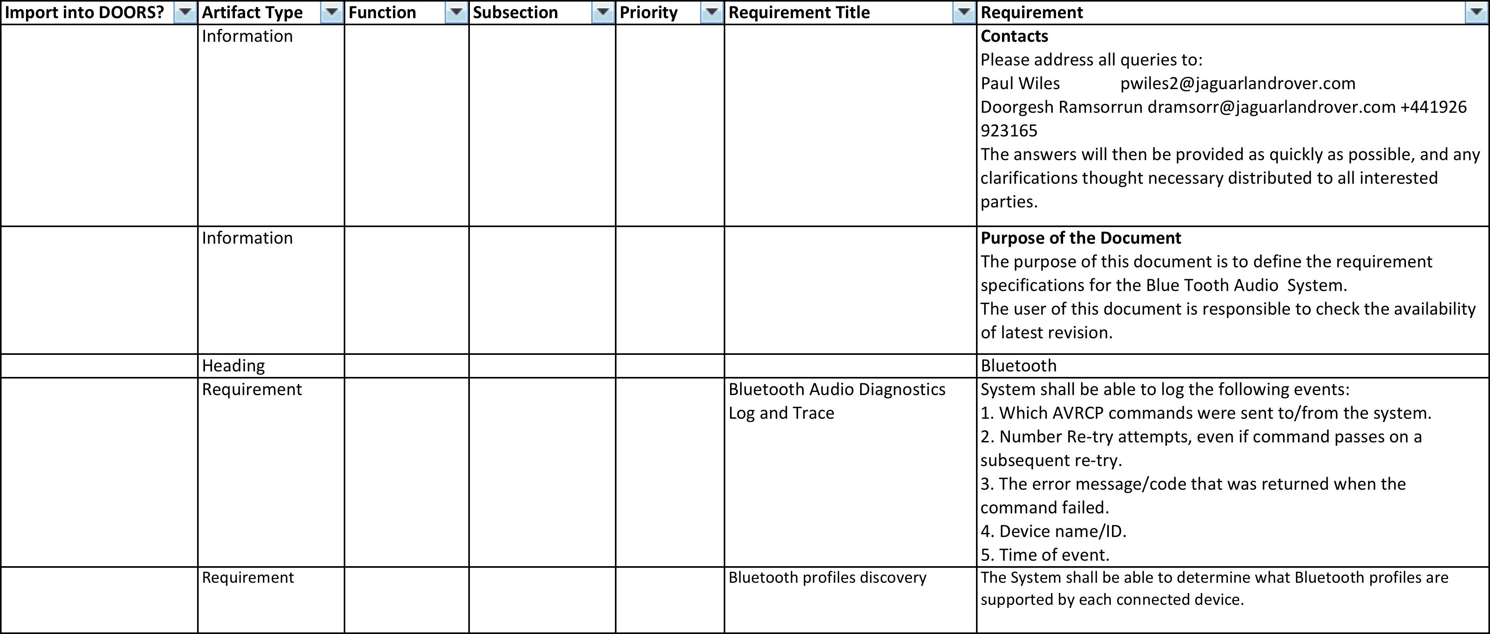
Sample DPR - Start

Slide 20
DPR – Enumerated Attributes
Pick Lists Available for these fields

Slide 21
DPR – String Attributes

Slide 22
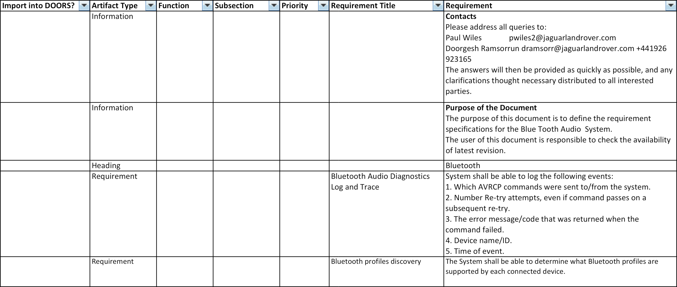
DPR – String Attributes
If “Import into DOORS = “Yes”
This is the content that will appear in the spec

Slide 23
DPR – Spec mapping
Identifies which section the requirement belongs in the spec

Slide 24
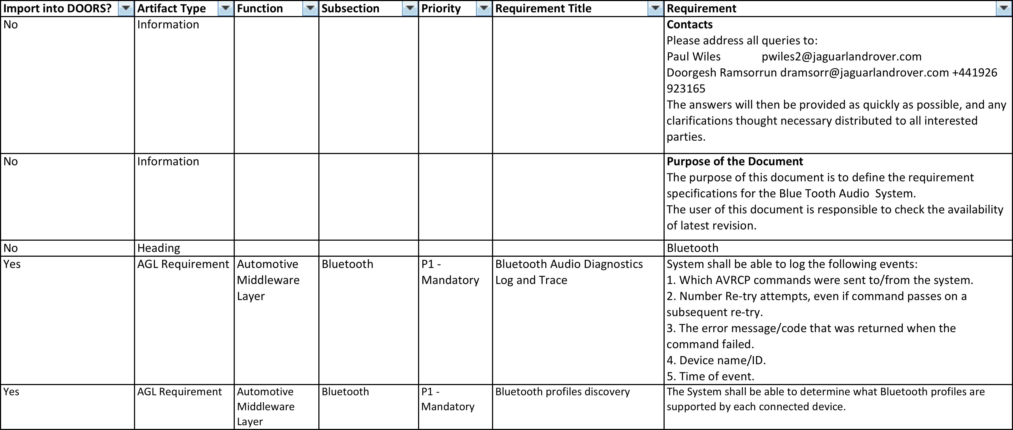
Sample DPR - Finish

Slide 25
AGL Spec Project

Slide 26
AGL Spec Project
Mail list created automotive-rqmts@lists.linuxfoundation.org
Project Wiki Page Created https://wiki.automotivelinux.org/project-agl-spec-v1.0

Slide 27
References
IBM Rational User Education (YouTube) - Introduction to IBM Rational DOORS NG
http://www.youtube.com/playlist?list=PLZGO0qYNSD4X757uGAmkWhieGknL4asHl

Slide 28
Thank You

