Slide 1
Automotive Grade Linux System Architecture Team
February 5, 2015

Slide 2
Meeting Attendees
Attendee | Company | Present
Arthur Taylor | Advanced Telematics | Yes
Isao Ishibashi | Fujitsu TEN
John Avery | Panasonic | Yes
Abhishek Soni | Panasonic
Takehiko Yasuda | Panasonic
Johan Thelin | Pelogicore
Brett Branch | Intel
Michael Fabry | Microchip
Paul Wheller | JLR
Phil Rutten | JLR | Yes
Andy Wells | JLR
Rick De Vriese | Symphony Teleca
Tatsushi Yamamoto | Denso
Yoshiyuki Miki | Renesas | Yes
Walt Miner | Linux Foundation | Yes
Nori Fukuyasu | Linux Foundation

Slide 3
Agenda
Announcements
AGL Spec Update
AMM Planning
New Business

Slide 4
Announcements
AGL AMM Feb 25-26 Tokyo
Registration deadline Feb 6
Embedded Linux Conference Mar 23 -25 San Jose
CFP https://events.linuxfoundation.org/events/embedded-linux-conference/program/cfp
Automotive Linux Summit June 1 -2 Tokyo
CFP: http://events.linuxfoundation.org/events/automotive-linux-summit/program/cfp

Slide 5
AGL Spec Update
Asked Steering Committee for Clarification
Meeting being set up for Monday 4 pm PST to discuss
Need to ask the steering committee to clarify the “mission of AGL”
Platform for innovation where new features are continually added and older releases have little to no support?
Expectation that there is long-term support provided so that a production program can use it with the expectation that regular security updates and bug fixes are provided?
Who is the consumer of the AGL spec?
What will the spec be used for?
Is the spec tied to a particular code release?
What is the cadence of releasing the spec? What is the cadence for releasing the code?
How are the code and spec tied together, if at all?
Is there a long term support plan for a given release of AGL code (e.g., security fixes)?

Slide 6
AGL Spec Update
DOORS NG Training planned for AMM
Set aside parts of both days to work on spec in real-time
DOORS NG Training will cover
Navigate the project/folders/modules/artifacts
Add a new requirement to the document.
Modify an existing requirement
Delete an existing requirement
Link a requirement to an artifact in the same or different module.
Print the latest version of the document or section of the document.
Print the latest release of the document or section of the document.
Initiating a review
Participating in a review
Closing a review
Change requests

Slide 7
AGL Spec Update
Work is being done in DOORS NG (doors.automotivelinux.org)
Project: AGL Project
Folders
AGL Requirements Definition -> Imported 0.82 Spec
Working version is broken up into two folders
Requirements (DPRs)
References (APIs)
We are anticipating that each of these working folders becomes its own document.
Finalizing the definition of what documents we need and what the contents should be

Slide 8
AMM Day 1

Slide 9
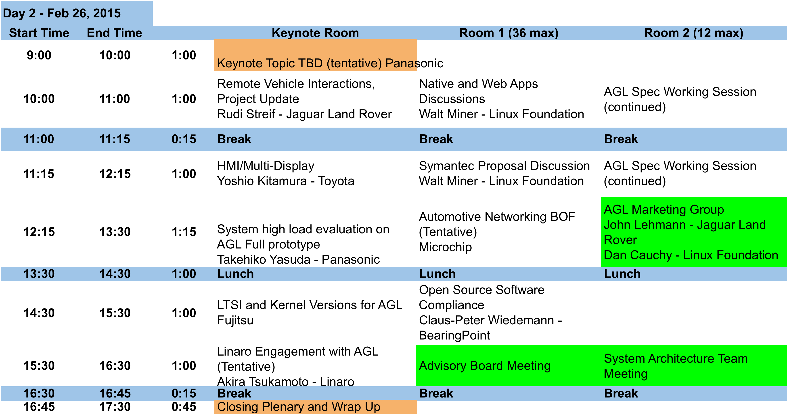
AMM Day 2

Slide 10
Symantec Proposal
Proposal sent to SAT for review
Symantec has proposed to embed their “roots of trust” into AGL/Tizen
IVI code
This is an IoT specific solution and it is different from a browser-based solution, for example some roots would have no expiration date which is applicable to embedded devices
This would be non-exclusive • Feedback
JLR: it is feasible for RVI but we would have to figure out the bigger picture from an LF view point
Linaro: planning to bundle root certificates with various engineering builds

Slide 11
Projects or Subprojects
Complete AGL Spec – JLR and Toyota to lead
Validate Crosswalk on Intel Platform – Panasonic, JLR, Intel
Validate Crosswalk on ARM platform – Panasonic and Renesas
Continuous Integration - Eureka and Intel
ARM kernel modifications - Renesas, Fujitsu Ten and Mitsubishi
Automotive Networking – Microchip
Reference Applications need to be identified and resourced

Slide 12
2015 Plans
Holiday Homework
Answer these questions.
Where should AGL be at the end of 2015?
What is my company doing to reach that goal?
How do I help meet that goal?
Is the project list still a good list?
Are there more collaborative projects with GENIVI like the media manager?
Deadline Second week of Jan for 2015 GENIVI MM phase 2 requirements
ARM board
Bluetooth AVRCP
DLNA
What is the SAT doing to help our members create an experience for their customers that is more compelling than Apple Car Play or Android?
What are the biggest impediments using Tizen for creating that experience?

Slide 13
Japan FTF - Expectation for 2015
Toyota want to work on the multi-display as well as refining AGL App Framework (on spec v0.82)
Panasonic will thoroughly test crosswalk on Intel during Jan, and then Renesas during feb, then develop an app to test the capacity of Crosswalk during March.
Renesas, Fujitsu Ten and Mitsubishi will work together to work on the kernel.
Fujitsu Ten will develop an app to test the fastboot as well as back-camera app.
AisinAW hopes to aggregate requirements for Navigation systems.
Denso hope to port the real production software to AGL prototype and test.
Eureka wants to contribute in terms of testing.
NTT DATA MSE hopes to create some solutions based on AGL full-prototype
Want to out-put more codes and test by AGL members.
Thoroughly test the reference hardware.
Improve the maturity of AGL components/distribution.
Improve the communication among the members. Need more opportunities for F2F among the global members.
Take more advantage of community (AGL/GENIVI/ Tizen etc).
Increase dialogues with other organizations. (GENIVI/OSADL etc)
Recruit more AGL members.

Slide 14
Thank You
Notes:
14

