Slide 1
Linux experience in DENSO
1. Introduction of DENSO
2. History and Future: IVI system with Linux
3. OSS Activity in DENSO
4. DENSO’s contribution to AGL
5. Vision of future products
6. Key message
This information is the exclusive property of DENSO CORPORATION. Without their consent, it may not be reproduced or given to third parties.

Slide 2
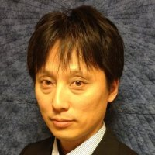
Who am I ? (Self-Introduction)
Kazuo Tsubouchi
DENSO CORP.
General Manager
Kazuo Tsubouchi started to work for DENSO Corp. in 2001. as a software engineer of DENSO Navigation system. Since then, he has been working for device driver, middleware and operating system related software. He has developed such kind of software running on WindowCE, RTOS, Linux. And since 2010 he focused on the embedded Linux system for DENSO IVI system. Kazuo Tsubouchi is currently General Manager of ICT(Information and Communication Technology) Div 2 at DENSO Corp. He has the responsibility for the Platform development of DENSO (current and future) IVI system.

Slide 3
DENSO is ...

Slide 4
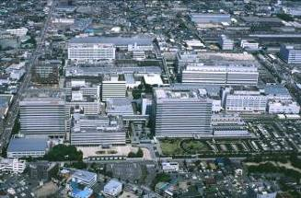
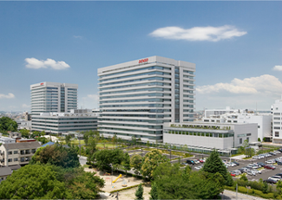
Profile
Corporate Profile
Corporate Profile
Established
December 16, 1949
Capital
187.4 billion yen (US$1.6 billion)
Revenue
Consolidated basis
4,309.8 billion yen (US$35.9 billion)
Operating Profit
Consolidated basis
331.4 billion yen (US$ 2.8 billion)
Employees
Consolidated basis
Non-consolidated basis
146,714
38,493
Consolidated Subsidiaries
188
(Japan 61, North America 28, Europe 35, Asia 58, South America/Others 6)
Affiliates under the Equity Method
35
(Japan 13, North America 4, Europe 4, Asia 12, South America/Others 2)
*There is one non-consolidated subsidiary.
Notes:
U.S.dollar amounts have been translated, for convenience only, at the rate of 120.17 yen = US$1,
the approximate exchange rate prevailing on March 31, 2015. Billion is used in the American sense of one thousand million.
/ as of March 31, 2015

Slide 5
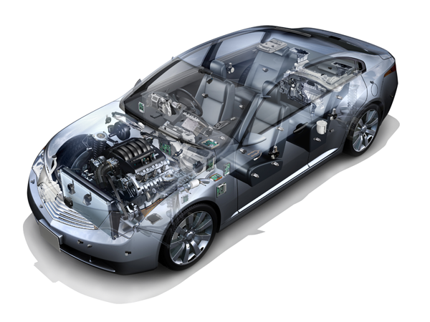
Automotive Fields
Corporate Profile
Environment
Safety
Hybrid and electric vehicle components,
Products for fuel cell vehicles,
gasoline engine management system,
diesel engine management system,
starter, alternator, radiator, etc.
Sensing technologies for driving assist systems,
actuator & computer for antilock brake system (ABS) /
electronic stability control (ESC),
adaptive front-lighting system (AFS),
airbag sensors & electronic control units,
periphery monitoring system, instrument cluster,
rain sensor for automatic windshield wiper, etc.
Comfort & Convenience
Car air-conditioning system,
air conditioner for buses, air purifier,
Car navigation system,
electronic toll collection system (ETC),
remote security system,
remote touch controller, smart key,
advanced vehicle operation system (AVOS), etc.

Slide 6
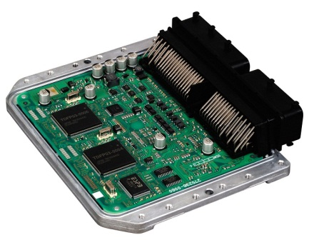
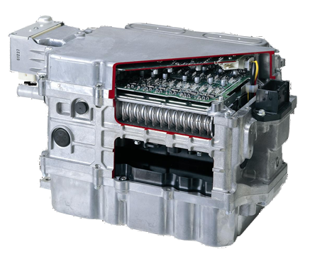
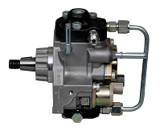
Main Products (Environment)
( Hybrid Vehicle Electronic Control Unit)
Starter
Radiator
Alternator
Gasoline Engine Management System
Environment
(Power Control Unit)
(Supply Pump for Passenger Cars)
Hybrid and Electric
Vehicle Components
Diesel Engine Management System

Slide 7
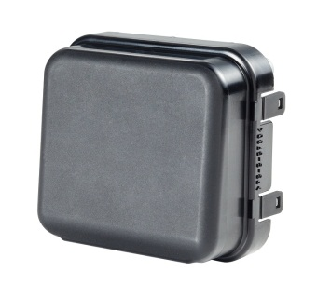
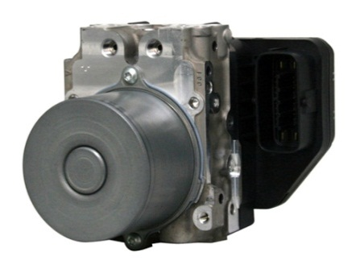
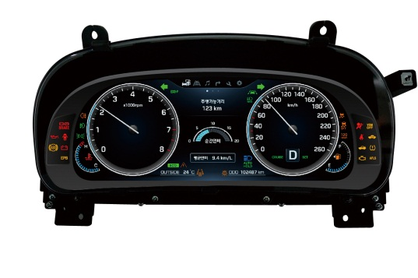
Main Products (Safety)
Actuator & Computer
for ABS/ESC
Sensing Technology for Driving Assist System
(ESC Unit)
(Millimeter-Wave Radar Sensor)
Headlamp Control System for AFS
Airbag Sensor & Electronic Control Unit
Safety
Instrument Cluster
Periphery Monitoring System
Wiper System
（Full Graphic Type）

Slide 8
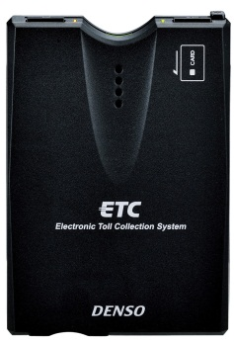
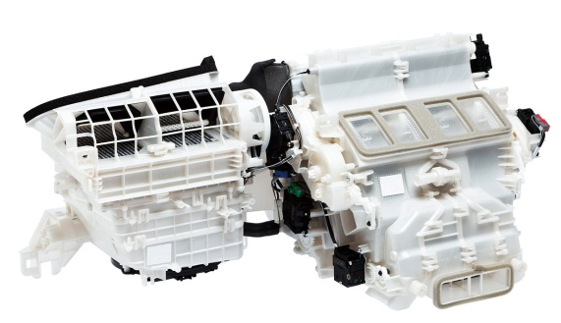
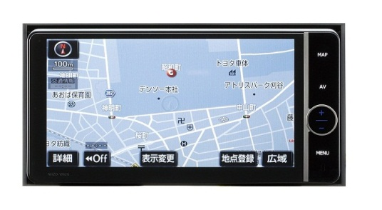
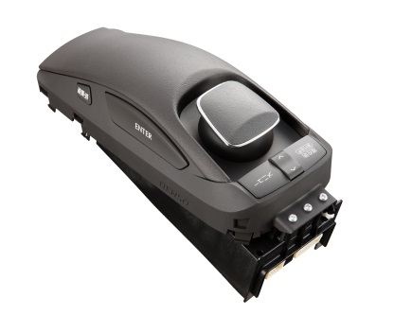
Main Products (Comfort / Convenience)
Air Purifier
Bus Air Conditioner
ETC On-Board
System
(HVAC Unit)
Air Conditioner System
Remote Security
System
Convenience
Comfort
Car Navigation System
Advanced Vehicle
Operation System (AVOS)
Smart Key
Remote Touch
Controller
(Car Navigation System)

Slide 9
DENSO is ...
Automotive parts company
with embedded software

Slide 10
History and Future:
IVI System with Linux in DENSO

Slide 11
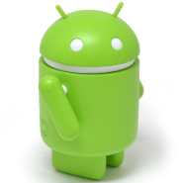
IVI and Car Navigation with Linux
Back Ground (Before Linux)
~2008: DENSO developed Car Navigation by T-Kernel(RTOS).
Source code has been increasing to over 5Million lines.
The Year, 2008, was a turning point in CE and Embedded system.
Smartphone launched
iPhone 3G and Android
CE/Embedded system have already used Linux for many products.
DENSO started developing Linux base Car Navigation system from 2008

Slide 12
IVI and Car Navigation with Linux
Gen1: Launching
2008-2012(L/O）
Gen2：Bringing up
2012-2016(L/O）
Gen3：Future
2016-2019（L/O?)
Join Linux Foundation and GENIVI.
AGL Platinum member
Car Navigation
Media Player
Bluetooth
Telematics
Browser
Radio
Voice Recognition
,,,,
Bluetooth
Telematics
Radio
,,,,
Car Navigation
Media Player
Browser
Voice Recognition
,,,,
Car Navigation
Media Player
Browser
Voice Recognition
,,,,
Reuse
proprietary
Integrate
Linux Apps
Open
Collaboration &
Synergy
Proprietary software from tkernel to Linux AS IS.
50%
50%
100%
GENIVI/OSS
AGL distro
Original Linux
MOVE FAST in Next(3rd) Generation

Slide 13
Gen1: Launching(Dark Ages)
Strategy: Reuse Proprietary Software as much as possible. ⇒ RTOS software migration.
 | RTOS | Gen1: Original Linux | Issues
Distribution | T-Kernel | Original Linux Still needs to effort maintain by DESNO alone. | The latest security patches. Much effort to fix bug. Limited number of Engineers to maintain.
Interface | T-Kernel interface only. Proprietary interfaces… | Posix interfaces only. Proprietary interfaces… | The latest application/features Maintain proprietary middleware
Integration | Own integration tools | Inherit Own integration tools | Need efforts to integrate Apps with own integ tools. Maintain own integ tools.
Get knowledge and Experience of Linux
Not get benefit because of much effort; own implementation
⇒ How to reuse Linux Ecosystem more??

Slide 14
Gen2: Bring Linux more(getting better)
Strategy: Reuse GENIVI/OSS as much as possible
 | Gen2: GENIVI/OSS | Achievement
Distribution | GENIVI Compliance Linux | Speed up to fix bugs Easy to find engineers worldwide.
Interface | GENIVI Interface OSS contribution as well Wayland, GENIVI, AGL, Tizen | Collaborate partners in GENIVI. Bringing up OSS to automotive quality.
Integration | Yocto Jenkins | Easy integration of OSS. Easy maintenance of integ tooling. Automated testing

Slide 15
Gen2: Architecture and Interfaces
Target to use Standard Interface with OSS, GENIVI. Keep compatibility inter Products.
50% applications reusable!!
HMI
Car Navigation
Telematics
Back Guide Monitor
Media Player
Speech Recognition
Still depend on proprietary interface. This shall be common thought AGL!
HMI Framework
Wayland-IVI-Extension
Audio Mgr.
DLT
Persistency
DeviceMgr.
Conn.
Mgr.
Life cycle
Automotive feature
CAN
plugin
Wayland/
Westond
Gstrea
Mer
EET
udev
Systemd
contribute IVI requirement.
dhclient
pppd
Filesystem
RPM
Socket
IPC
Use OSS
as it is.
IVI-shell
ALSA
TCPIP
Linux Kernel
DENSO is using Key standard interfaces, Graphic, Audio, and Log for applications to allows to reuse the application.

Slide 16
OSS Activity in DENSO

Slide 17
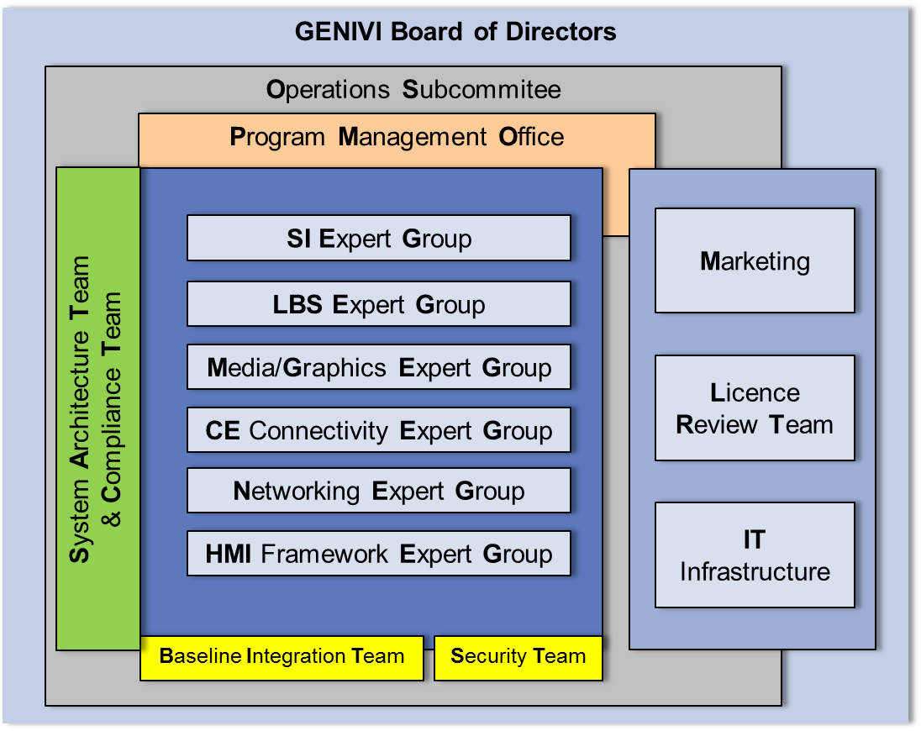
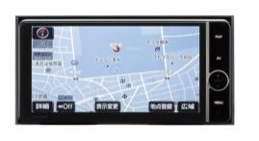
DENSO OSS achievement
System Architecture Team
More than 100 engineers active working with Product development.
Bringing up OSS to Product ready!
Tech session in GENIVI/AGL!
Feedback product quality to OSS!!!
Expert Group
Expert Group
Expert Group
Alignment and harmonization
In technical point of view
Feedback
System Infrastructure: - Lifecycle management, Persistence subsystem
- Diagnostic Log and Trace (DLT)
Product
development
Media and Graphics: - Audio Manager
- IVI Layer Manager (Weston, ivi-shell extension)
Contribution
CE Connectivity: - Media-Playback, Smart Device Connectivity
Networking: - Inter Node Communication (e.g. App processor and Vehicle processor)
- Ethernet-based networking (e.g. AVB, DoIP)
DENSO’s contributions are well-recognized in GENIVI !
“Most Valuable Contributor” for the 3rd consecutive years: 2012: Jürnjakob Harder, 2013: Marko Hoyer, 2014: Nobuhiko Tanibata

Slide 18
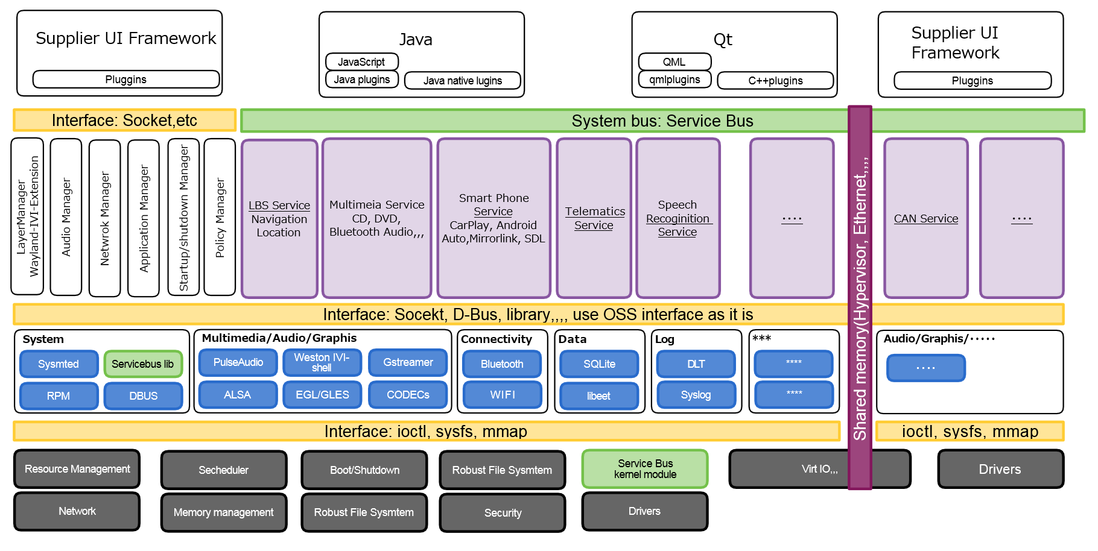
DENSO OSS achievement for cockpit
DENSO can propose reference implementation for Franca IDL.
DENSO can propose reference implementation for Franca IDL.
Multimedia ECU
Instrument cluster
ECU

Slide 19
DENSO OSS achievement for cockpit
DENSO can propose Standard way to manage HMI to be displayed in Inter ECUs.
Multimedia ECU
Instrument cluster
ECU
Telematics
information
Traffic Jam information
Standard Protocol at Wayland/Weston
Several Physical communitcation would be supported. E.g. virtIO, EthernetAVB, or RTP

Slide 20
What DENSO can contribute to AGL
DENSO experience,
Bringing up OSS to Product ready by Product dev. team
OSS contribution; in Product dev.team
DENSO would like to / can contribute to AGL
Production ready components
Usecase and Quality for AGL to be product ready
Why DENSO will do that ?
Next page will show why DENSO contributes them...

Slide 21
Vision of Future products

Slide 22
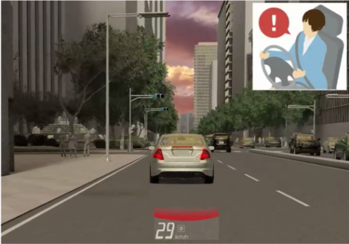
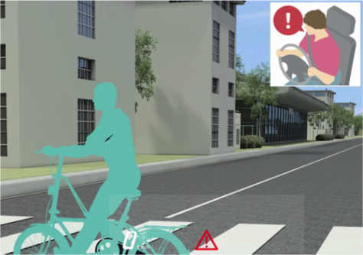
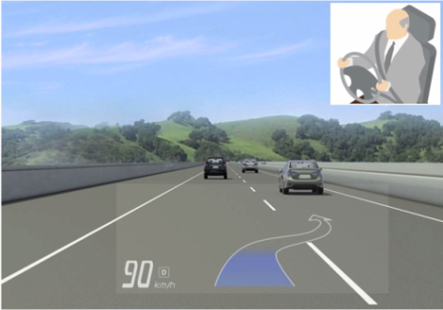
DENSO Approach to “Cockpit System”
DN Cockpit System
Society
Infotainment
✓ Protect driver’s assets using information management
✓ Protect driver’s safety under the management of HMI
✓ Provide much more convenient environment using IT services
Big data
Society infrastructure
Mobility
Infotainment
Mobility
ADAS
ADAS
Human
Services
Vehicle control security access
Vehicle information control / notification
Cyber security
Software Update/Maintenance
HMI management
Information management
Interaction / Communication
Recognition of driver’s condition
Intelligent HMI
Vehicle
Driver’s Status
Face Direction
Evolution of vehicle (Environment/Safety/Convenience)
Adaption to Driver’s status
Driver’s Driving Style
Provide Enhanced Service based on HMI & Information Management

Slide 23
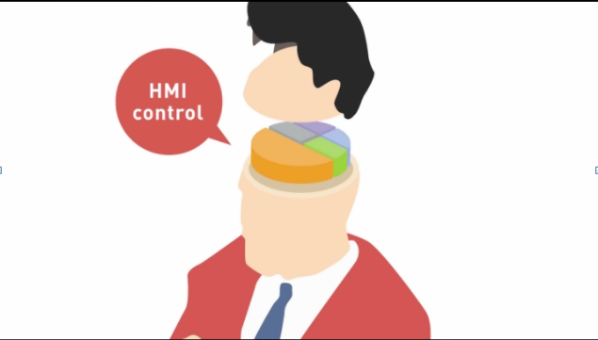
What is HMI Management

Slide 24
Key message
Those system cannot achieve only by DENSO !
More collaboration and Synergy is needed !
That is …
The ‘three-way satisfaction’ it refers to means that what benefits you, should ultimately also benefit your partners and society at large.
Customer
Sprits of SANPO-YOSHI
（三方よし)*
Community
Supplier
*:http://www.sanpoyoshi.net/sanpou-e/index-e.html

Slide 25
Thank you
for your attention!

