Slide 1
Reference Hardware, System Architecture
EG.
AMM 2018 Tokyo
2018.02.19
SEIJI GOTO
Mazda Motor Corporation

Slide 2
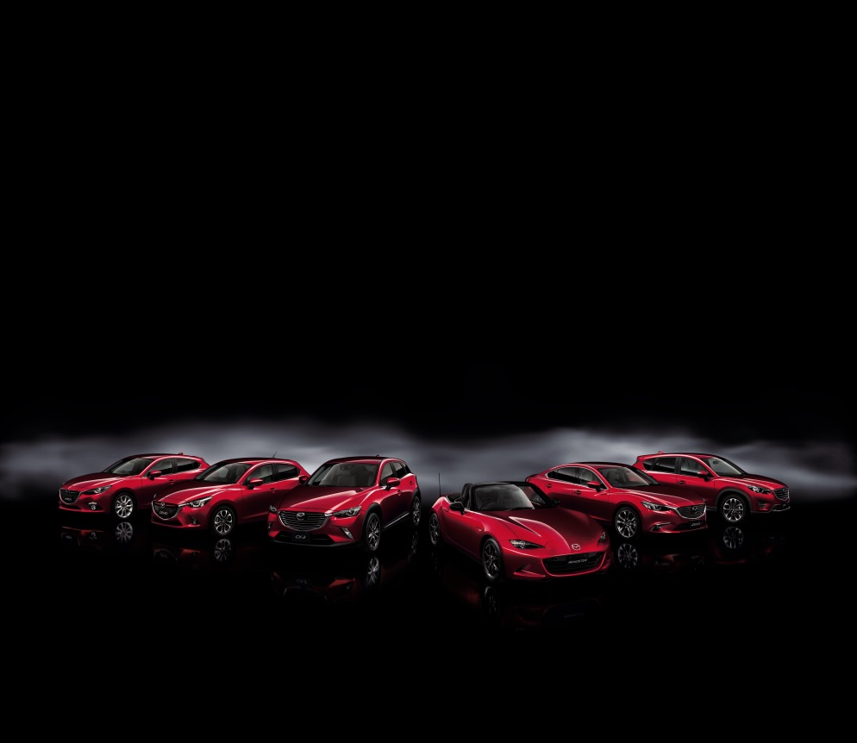
Multiple OEMs and Types of Cars
AGL OEMs
Types of Cars
DAIMLER,
HONDA, MAZDA
MITSUBISHI MOTORS
NISSAN, SUBARU
SUZUKI, TOYOTA
Compact · Sports · Luxury
Sedans · SUVs · Crossovers
Electric Cars, Hybrid Cars
Infoteainmentの
The Diversification of IVI system
configuration is inevitable.

Slide 3
Compatible with various IVI system
Integrated Infotainment System
2DIN System
50
km/h
H/U
DCM/TCU
H/U
AMP
x
x
x
x
If AGL can work on both systems, (just like laptop and desktop)
it will solve the problem of the current IVI development workload.

Slide 4
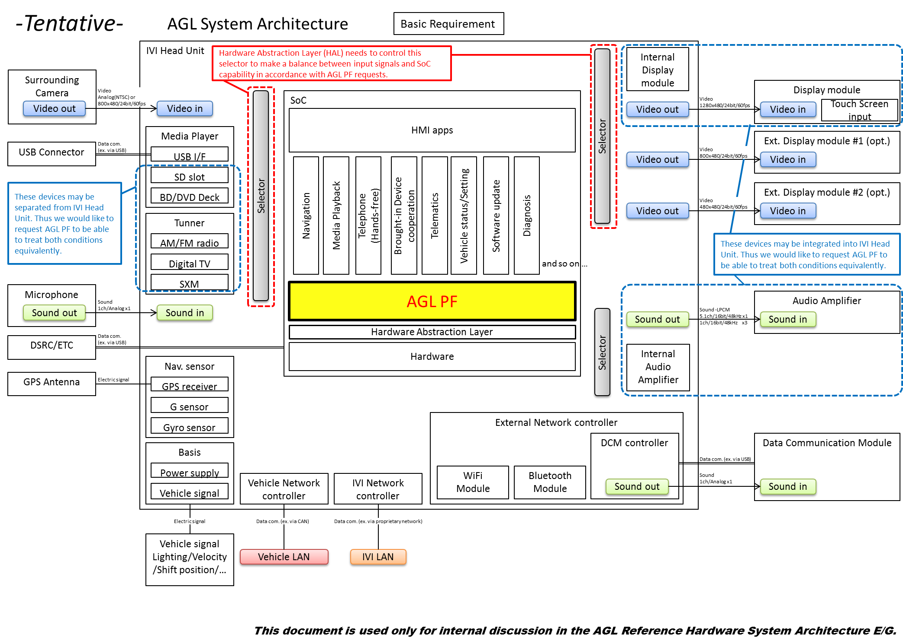
Example of System Architecture compatible with various combinations of peripherals.
Common requirements
Various hardware requirements

Slide 5
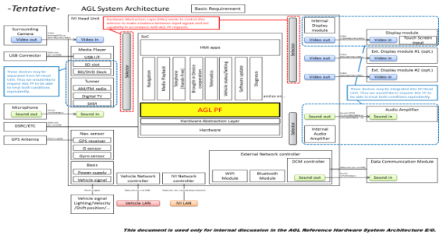
Define Reference Hardware Architecture
Common Requirements
Various hardware requirements
Reference Hardware
(for AGL PF)
Tentative
Reference Hardware
(for luxury spec)
Reference Hardware
(for compact spec)
Community
Board
Main Board
Deck
Main Board
Display
GPS
Display
BT/Wi-Fi
Tuner
Ethernet
BT/Wi-Fi
Camera
Ext Board
USB
Display
Deck
AV control
processor
Ext Board
RSE
Tuner
Ext Display
Deck
Tuner
BT/Wi-Fi
…
CAN
controller
CAN
controller
CAN
CAN
4

Slide 6
(a) Reference Hardware Specification Document
- Spec V0.1.0 (Open Draft) was published on October 18, 2017.
https://wiki.automotivelinux.org/_media/eg-rhsa/agl_referencehardwarespec_v0.1.0_20171018.pdf
Major Policy : Main board and Extension board can be combined freely.
Main Board
(SoC-A high grade)
Main Board
(SoC-A low grade)
Main Board
(SoC-B)
Scope of RHSA-EG
AGL Reference
Ext Board
(luxury)
AGL Reference Ext Board
(compact)
Ext Board
(for OEM-X)
Ext Board
(for OEM-Y)

Slide 7
(b) Reference Hardware Development (2018)
Collaboration between RHSA-EG and Renesas, Intel, Shimafuji
works even in
stand-alone
works even in
stand-alone
Main
Board
R-Car Gen3
Starter Kit
(Renesas)
Intel Arch.
Main Board
(Intel)
Common I/F set
Extension
Board
Kingfisher
Board
(Shimafuji)
<1st step>
We will start development to connect
Intel Arch Main Board and Kingfisher.
CES2018 Demo System
(Current representative Reference HW)

Slide 8
(b) Reference Hardware Development (next step)
Collaboration between RHSA-EG and SoC vendors
works even in
stand-alone
works even in
stand-alone
works even in
stand-alone
Main
Board
R-Car Gen3
Starter Kit
(Renesas)
Intel Arch.
Main Board
(Intel)
Other
Main Boards
(Other SoC maker)
Common I/F set
Extension
Board
Kingfisher
Board
(Shimafuji)
AGL Reference Ext Board A
(e.g. luxury)
AGL Reference Ext Board B
(e.g. compact)
<next step>
Eventually the variations of extension boards
need to be increased.
Reference Hardware
2018

Slide 9
Schedule
 | 2017 |  | 2018 |  |  |  | 2019
 | Jul-Sep | Oct-Dec | Jan-Mar | Apr-Jun | Jul-Sep | Oct-Dec | Jan-
ALS
AMM
CES
AMM
ALS
AMM
CES
RefHW
Demo System
Keynote
(Mazda)
RC1
RC2
RC3
6.0.0
RC1
RC2
RC3
7.0.0
AGL FF Development
AGL GG Development
Spec v0.1
(open draft)
SoC vendors
joined
Spec v1.0
RefHW (2nd Step)
Requirements
???
System Architectural
Design
Define RefHW spec
(Common I/F set)
???
SW Requirement
Extraction
Demo System
Development
Intel Main Board
Development
BSP for Main/Ext Board
Development

