Slide 1
About Product-level Code from TOYOTA
TOYOTA MOTOR CORPORATION
Toshikazu Ohiwa
Notes:
I am sorry that I cannot go to Berlin this time. I’d like to want to talk about this theme today.

Slide 2
Agenda
Proposal at previous AB (Jul, 2019)
Filling the gap between the current AGL UCB and production-level code ASAP
About the software that Toyota disclose code
Spec EG activity: Toward Spec 2.0
Notes:
The agenda is as follows. First of all, I’d like to talk about what we proposed at previous AB in July. Next, I’d like to talk about the software that Toyota disclose code. Finally, I’d like to talk about Spec EG activity

Slide 3
Proposal at previous AB (Jul, 2019)

Slide 4
Background
In AGL’s Advisory Board (AB), we proposed that we would like to fill the gap between the current AGL UCB and product-level code.
Notes:
I ’d like to talk about what we proposed at the AB in July. As background we declared that we would like to fill the gap between the current AGL UCB and production-level code. Therefore, we raised 4 points as points for discussion. ・ How to make AGL UCB closer to product ready ・ How to integrate contribution from product code ・ Shift of spending development fund from Demo purpose to Product readiness ・ How to monitor progress of funded development, and navigate them efficiently

Slide 5
Overview
<Proposal-1>
Improvements of managing funding developments
AGL governing body (AB, SC, SAT) should involve more on management of the funding development, especially in budget approval and progress/result evaluation.
<Proposal-2>
Filling the gap between the current AGL UCB and production-level code ASAP
The gap should be filled as much as possible, and as soon as possible.
Encourage members to contribute product-level code.
Leverage the development find for the purpose.
5
Notes:
I proposed two points. One is ... The second is ...

Slide 6
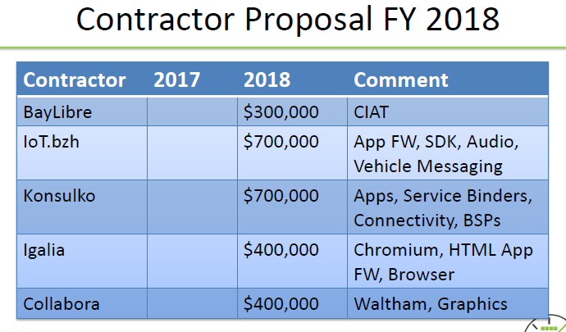
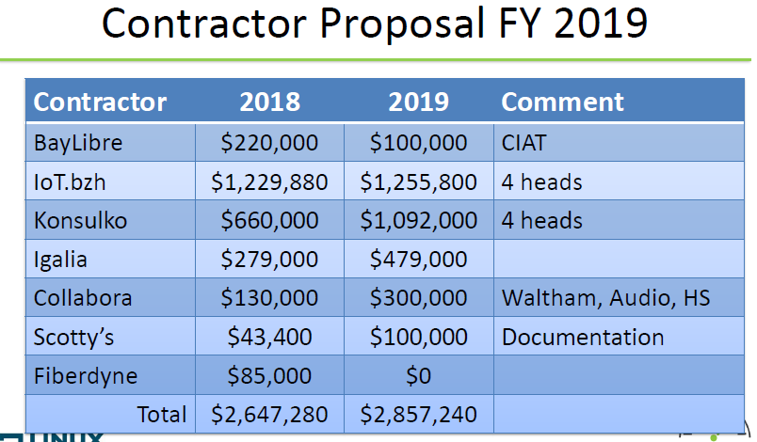
Improvement of funding development (1/2)
1. Issues in management of AGL our sourcing
<Current situation>
 | 2018/4Q | 2019/1Q | 2019/2Q | 2019/3Q | 2019/4Q
Company-A
★AB
★AB
★AB
★AB
(Issue #1)
Approved by amount of money
(Issue #2)
No progress report
(Issue #2)
Result are not examined
(Issue #3)
Contents of funding is not discussed
Issues #1 : Our sourcing tasks are ambiguous. Detailed tasks of out sourcing (SoW) are not clear at the timing of budget approval. Its total budget amount is examined, but their contents are not well examined by AB.
Issues #2 : Progress and artifacts of the outsourcing development are not well monitored.
Issues #3 : Contents of the funding is not well discussed.
<Comparison AMM Winter data at FY18 vs FY19>
Tasks were not described
Tasks were presented
Data presented at Feb 19, 2018 AB
Data presented at Mar 4, 2019 AB
6
Notes:
I’d like to talk about the first proposal. First, about Issues in management of AGL out sourcing. As a current situation, there are Isseus.
Issues # 1 and Issues #3, at 4Q timing contents of the funding is not well discussed.
Issues # 2, we has not seen development status in terms of contract scope.

Slide 7
Improvement of funding development (2/2)
<Proposal of the improvements>
 | 2018/4Q | 2019/1Q | 2019/2Q | 2019/3Q | 2019/4Q
Company-A
★AB
☆SAT
★AB
★AB
★AB
Check the progress at SAT
☆SAT
Contents of funding should be discussed
Check the result at SAT
Improvement proposal #1:
Circulate the detailed SoW among SC and AB, and examine the detail before budget approval.
Improvement proposal #2:
The progress of out sourcing is examined by SAT at every quarter and report it to the AB.
Improvement proposal #3:
When new adding items to be developed by out source is come up, then it should be discussed and approve at Fall-AB.
7
Notes:
So, We proposed the improvements.
Improvement proposal #1
Improvement proposal #2
Improvement proposal #3
I think that those improvement proposal are one of how to make AGL UCB closer to product ready.
And I think that it is necessary to discuss next year's items at the next AB.

Slide 8
Issues of gap for production (1/2)
2. Issues of the gap between AGL and product-level code
There are too much gap between AGL and product-level code (in API)
Cover ration = (# of AGL APIs) / (# of Product-level code APIs)
# | Function | Function detail |  | Cover ratio | Abstract of the Gap
1 | App FW | ① | App FW | ７％ | Application lifecycle management
2 | Services | ① | Voice recognition | ４％ | Voice control of services (Radio, Phone call, media player, etc.)
 |  | ② | SW update | ０％ | SW update notification, download, install
 |  | ③ | Comm. Mgmt. | ４８％ | Routing though external devices, Priority control
 |  | ④ | Modem | ０％ | MTU setting, Error handling, etc.
 |  | ⑤ | Smartphone Connectivity | ０％ | Framework to deploy CarPlay, Android Auto, etc.
 |  | ⑥ | Media player | １５％ | Integration in other services
 |  | ⑦ | Radio | ８％ | Call preset station, regional specific station search (ex. RDS)
 |  | ⑧ | TV | ０％ | DTV reception and control
 |  | ⑨ | Bluetooth | ８％ | Hands-free (Call, Phone book search, answering), mailing and messaging
 |  | ⑩ | Remote vehicle control | ０％ | Remote vehicle maintenance
 |  | ⑪ | Vehicle info & control | １５％ | Vehicle control setting and display
3 | Basic System | ① | Kernel and drivers | ８％ | System hardware resource control, power management, device lifecycle management
 |  | ② | Diagnostics | ０％ | Logging and reporting hardware/application error
 |  | ③ | Location (GPS) | ８０％ | Location data handling
 |  | ④ | Drawing | １００％ | Window manager, Display-out control
 |  | ⑤ | Sound | １００％ | Routing sound, Sound output control
8
Notes:
I’d like to talk about the second proposal.
First, about issues of the gap between AGL and product-level code
There are too much gap between AGL and product-level code (in API)

Slide 9
Issues of gap for production (2/2)
Resolution proposal #1:
Contribute the product-level code to AGL community
If the contributed code is new code, use as a base of AGL community development.
If the contributed code is overlapping existing AGL code, start to consider to integrate the functionality into AGL code.
Resolution proposal #2:
If no volunteer for the integration work, leverage the development fund.
Ex.) Spec EG defines SoW based of discussions among company developing product-level code (OEM, Tier-1, etc.).
9
Notes:
So, We proposed the resolutions.
Resolution proposal #1
Resolution proposal #2

Slide 10
Note: Priority of filling the gap
Ex. Priority of Low grade products based on Browser
High Priority ： For OEM Common（Standard Soft.）
Middle Priority： For Common Grade
Low Priority ： For High Grade
Toyota can contribute
High Priority
Middle Priority
Low Priority
# | Function |  |  | Coverage | Requirements with gaps | Assignment Idea
１ | App FW | ① | UI Tool-Kit | ７％ | GUI Library | Out of Scope
２ | Service | ① | Browser | ― | Security patch update | AGL(Fund)?
 |  | ② | Smartphone cooperation | ０％ | SDL、(Contract required for Car Play、Android Auto) | AGL(Fund)?
 |  | ③ | Arbitration | ４８％ | Priority control（display, sound, communication） | AGL Member
 |  | ④ | Vehicle information | １５％ | Display and setting for vehicle | AGL Member
 |  | ⑤ | Bluetooth | ８％ | Hand free(incoming, Answering, Calling, Phonebook)、mail | AGL Member
 |  | ⑥ | Re-programing | ０％ | Program update | AGL Member
 |  | ⑦ | DCM | ０％ | Data communication control | AGL Member
 |  | ⑧ | Radio | ８％ | Preset registration/Calling、Destination Func. | AGL Member
 |  | ⑨ | Voice recognition | ４％ | Each service(Radio、TEL、MediaPlayer、etc.） control | AGL Member
 |  | ⑩ | D-TV | ０％ | Receive and operation | AGL Member
 |  | ⑪ | Media Player | １５％ | Basic operation、other service cooperation | AGL Member
 |  | ⑫ | Remote Service | ０％ | Remote maintenance service | AGL Member
３ | System | ① | Basic system | ８％ | Resource management、Power Management、Device management、etc. | Toyota
 |  | ② | Location information | ８０％ | Location information of GPS | Toyota
 |  | ③ | Display system | １００％ | Window Management、Display output
 |  | ④ | Sound system | １００％ | Routing and output of sound
Gap： Use API number of each function for product and AGL
＊Coverage =API number of AGL / API number of Product
10
Notes:
The tables on this page are prioritized to fill the gaps. No decision has been made
However, if the priority and the person or company in charge of developing each function can decide, I think this is also one of how to make AGL UCB closer to product ready.
Have you had any questions or comments so far?
・・・

Slide 11
About the software that Toyota disclose

Slide 12
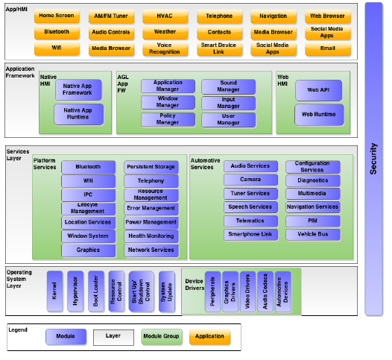
Relationship between AGL UCB code and Toyota product level code
The software that Toyota disclose today relate to the following components of AGL.
Services Layer: Platform Service
IPC
Location Service
Persistent Storage
Resource Management
Power Management
Error Management
Health Monitoring
Network Management
Operating System Layer
Resource Control
Startup/Shutdown Control
Device Drivers: Peripheral / Automotive Device
Example of missing features in AGL
Shutdown processing
Low power consumption when ACC-OFF
Data backup
Maintain user usage
Resource monitoring
Prevention of system stop or reset
Example of similar features in AGL
Touch-Panel input control
Location Service
Task manager
Notes:
Next, I’d like to talk about disclose production-level code
The software that Toyota will plan to disclose code is related to or included in the following components of AGL.
In the service layer, IPC, location, etc. In the OS layer, resource control, etc.
The software that Toyota will contribute is classified into two cases. There are missing features and similar fetures in AGL.
As an example of missing features in AGL, There is a shutdown process This is necessary to properly terminate each process to reduce power consumption when the vehicle status is ACC-OFF. There is also data backup This is necessary to retain user usage status
There is also resource monitoring This is necessary to prevent unexpected system stop or reset
So, regarding missing functions, I’d like to want add new features in AGL.
As an example of existing features in AGL,
There are Touch-panel device control, location and task manager.
Regarding those features, I’d like to want discuss weather to replace, coexist or keep existing.

Slide 13
Schedule for the activity
Jul
Aug
Sep
Oct
Nov
Dec
Jan
Feb
Mar
Apr
May
▲Proposal of product-level code disclosure
Prepare API documents
▲Disclose API document
#1
▲Disclose API document(update)
Toyota Activity
#2
▲Disclose API document(update)
Refactor the source code
#1
▲Disclose code
#2
▲Disclose code
▲Integration fix
AGL Activity
Integration
We want to discuss the way of source code integration and its schedule in SAT or EG
Maintenance
#1 : 7 modules of all 22 modules
#2 : All 22 modules
Notes:
I’d like to talk about schedule for disclosure.
Today, I disclose API documents
I will disclose code and updated API documents for 7modules in Oct.
So, For others, I will disclose in Dec.
At the stage of code disclosure,
I’d like to want to discuss planning and integration methods in SAT
Have you had any questions or comments so far?
・・・
common_library
framework_unified
notification_persistent_service
Communication
Config
interface_unified
system_manager
https://confluence.cr.toyota.co.jp/pages/viewpage.action?pageId=112931743

Slide 14
Explain function overview
Explain features
- Feature overview
- Relation diagram
- Use cases
Please refer other document: BaseSystem_Features.pdf
API Introduction
https://confluence.automotivelinux.org/display/TC/API+Documents
Notes:
I’d like to talk about feature overview by other document.
This document is written about feature overview, relation diagram, and use cases
Please refer other document.
Have you had any questions or comments so far?
・・・
I’d like to talk about API documents
I will put below next week.
Have you had any questions or comments so far?
・・・
Where should I put the HTML file?

Slide 15
Request
To Walt
Please assign the appropriate person to review API documents and source code that we disclose from now on.
To Reviewers
We would like you to review the software (documents and source code) in terms of following points
Some of the software is not in current AGL UCB. Therefore, please check that these software from us is acceptable to merge in AGL or not.
On the other hand, some software is similar to current AGL UCB. For these software, we would like you to propose
A: Replace AGL to Toyota software
B: Co-exist both AGL and Toyota Software
C: Reject to merge Toyota software
Also, please let us know the detail reason for above two terms.
Notes:
So, I have requests.
Have you had any questions or comments so far?
・・・

Slide 16
Spec EG activity: Toward Spec 2.0
Background and Current Status
We propose to update spec document from version 1.0 to 2.0
So, we requested to several OEMs to extract the requirements for AGL software in F2F @ Spain (May, 2019)
However, there were no new requirements from OEMs.
Re-Plan
We will proceed in other way to update spec documents.
Toyota will first propose the new requirements based on the software we disclose
Jul
Aug
Sep
Oct
Nov
Dec
Jan
Feb
Mar
Apr
May
▲Disclose API document
#1
▲Disclose API document(update)/ode
#2
▲Disclose API document(update)/code
Reschedule plan
Propose new requirements
Adding requirements for APIs
Notes:
I would like to continue talking about Spec.
The content is about the schedule.
First, about background and current status
We propose to update spec document from version 1.0 to 2.0
So, we requested to several OEMs to extract the requirements for AGL software in F2F @ Spain (May, 2019)
However, there were no new requirements from OEMs.
So, I thought about re-plan.
We will proceed in other way to update spec documents.
Toyota will first propose the new requirements based on the software we disclose
(Other features (especially APIs) will be added after disclosure.)
To OEMs member,
If you have requirements for other features, please ask me for additional requirements.
Have you had any questions or comments so far?
・・・
To OEMs
If you have requirements for other features, please ask me for additional requirements.

