Slide 1
Cluster EG Face To Face meeting 3rd
25/06/2019

Slide 2
Feature definition of IVI and Cluster
What is definition of IVI？
What is different point due to grade?
AGL original profile
＝Hi Spec AGL
Grade definition of Lo Spec AGL
Lo spec
Hi spec
AGL Cluster profile
＝Lo Spec AGL
IVI function
Cluster function
Lo spec
Cluster base
Hi spec
IVI base
e.g.）
AGL Cluster profile Lo spec
AGL Cluster profile Hi spec
AGL original profile
Lo
Hi
What is definition of Cluster？
Display size? Display resolution?
With HUD or without HUD?
Notes:
積み上げ：stack up
剥ぎ取り：stripping off

Slide 3
Target spec
What is reference hardware?
Which item should be defined?
e.g.)drawing performance、RAM size、ROM size？
Notes:
EGではClusterのアプリだけを扱うのではなくAGLのLo仕様システムとする。
そのシステム全般をEGで作り上げる目的とする。ただし、Clusterに関わるアプリ、サービスは
Hi仕様とも共通となるため共有化できる構造としたい。
デモはどうするか？

Slide 4
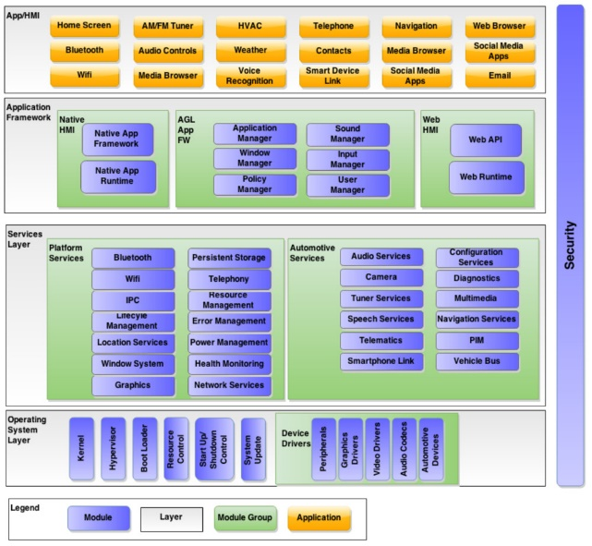
New architecture
What are missing parts that is necessary for Lo Spec AGL(=Cluster profile) in current architecture.
Archive functional safety (target is ASIL-B)
Fast boot
Software quality [e.g)LTS, tool]
ROM size shrink due to applied low spec hardware

Slide 5
New architecture
It shows comparison of current architecture and container architecture as below.
Idea |  | Architecture type | Strong points | Weak points
A | Current AGL | Monolithic | Simple for developers Easy to implement application for PoC Easy to change platform(e.g. add library) | Difficult to resolve dependency then the size increases soon Cost explosion on manufacturing to check the impact of software update
B | Container | Distributed | Impact of software update of container is small Lead time to manufacturing will be short than Monolithic less modification of host linux | Need skill to manage the host. PoC will be slow for developers Create container image for new feature Need container for automotive (e.g. pass through CAN)

Slide 6
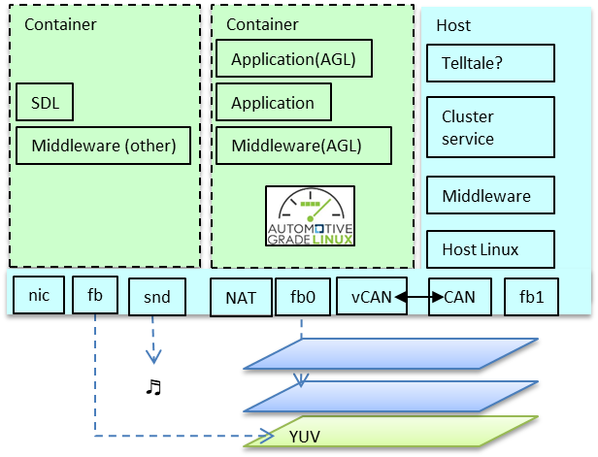
Why container architecture
[ Host ]
It is better to minimize customization after the product goes to market to reduce the verification cost
But security patch must be attached
If it has Functional safety, OEM has to do the process to get ASIL. So the smaller target of ASIL is, the smaller it costs.
[ Container ]
Need to update.

Slide 7
Container
Container Architecture
Container extends the features
[ Host ]
Linux Kernel is monolithic but have an ability to virtualize process group with container.
Host launch containers with resource(device, cpu, memory)
Host Linux is minimal structure, so launch faster.
→It is important that is defined basic IC
service.
[ Container ]
Container doesn’t affect other containers or host if some accidents occurs in the container.
Container can’t know the resource of other container or host
Ideally, Test only for container when software update
Host
* Provides device
* Manage resource
* Have critical task
(e.g. ASIL)

Slide 8
Schedule
2019 |  |  |  |  |  |  | 2020
Jun. | Jul. | Aug. | Sep. | Oct. | Nov. | Dec. | Jan. | Feb. | Mar. | Apr. | May
EG F2F | ALS (F2F) |  |  | AMM |  |  | CES
Sample
code
release
New architecture
release
Code release
based on
new architecture
Target spec
release
Spec
release
Notes:
EGではClusterのアプリだけを扱うのではなくAGLのLo仕様システムとする。
そのシステム全般をEGで作り上げる目的とする。ただし、Clusterに関わるアプリ、サービスは
Hi仕様とも共通となるため共有化できる構造としたい。
デモはどうするか？

