Slide 1
DSP Audio HAL
Fiberdyne Systems
https://github.com/fiberdyne/agl-4a-hal

Slide 2
Overview
Understand vehicle audio setup
Develop JSON configuration file

Slide 3
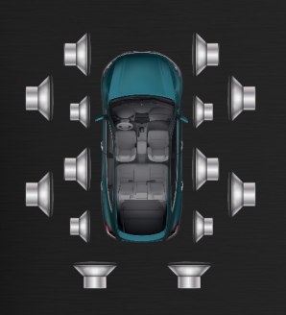
Vehicle Audio Setup
Up to 15 speakers definitions available
Configurable types through Engineering App
Full Range, Mid Range, Tweet, SubWoofer options available

Slide 4
Configuration File
Requires four main definitions:
Hardware
Zones
Streams
Controls

Slide 5
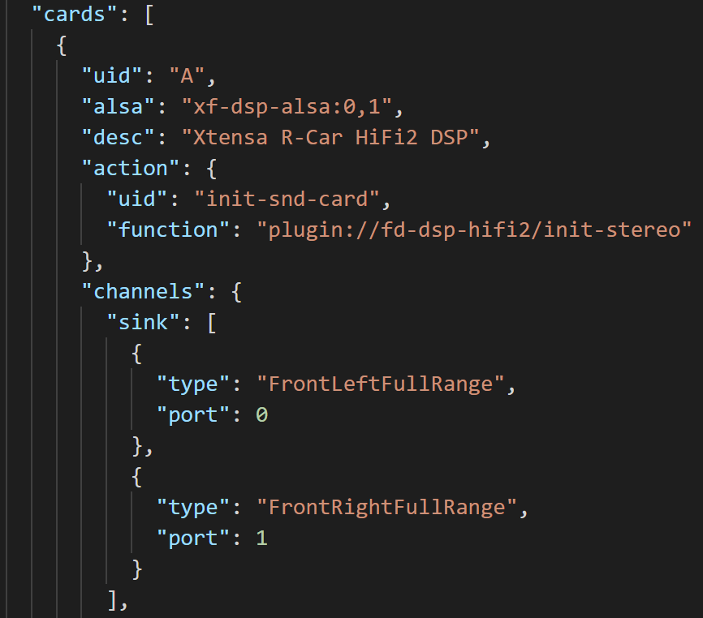
Hardware
Define the card
Channel Sinks
Speaker definition, and port number
Channel Sources

Slide 6
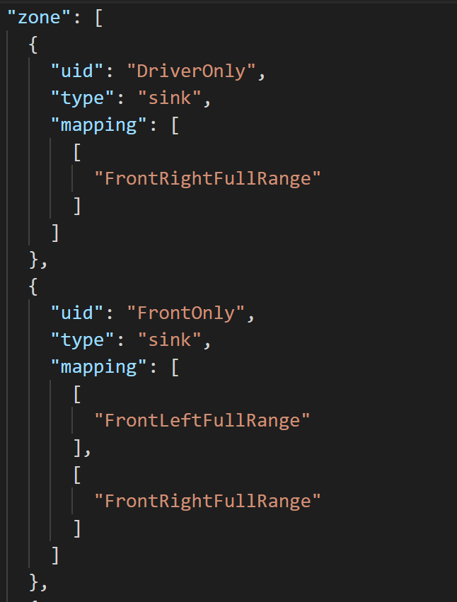
Zones
Define groups of speakers, called Zones
Map speaker to ordered audio input.
Eg. FL / FR / RL / RR / C / SW

Slide 7
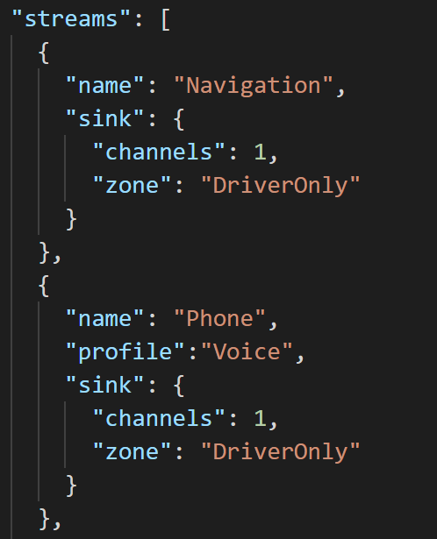
Streams
Defines the sound DSP Sound Card devices
Name/Role
Profile
Channels
Zone

Slide 8
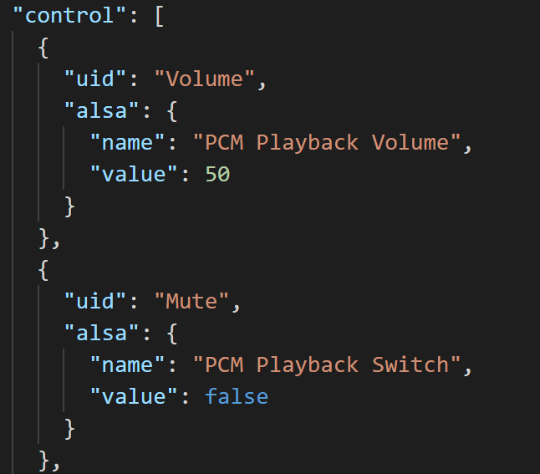
Controls
Plugin exposes controls
Configuration file defines additional control capabilities

Slide 9
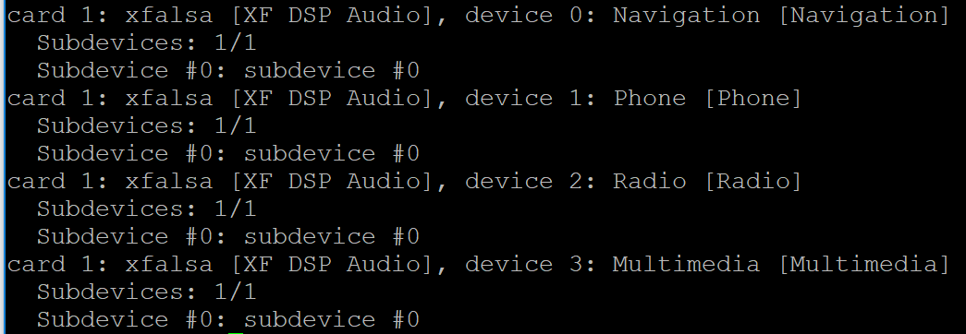
Result
Custom audio stream definitions
Configurable audio routing

Slide 10
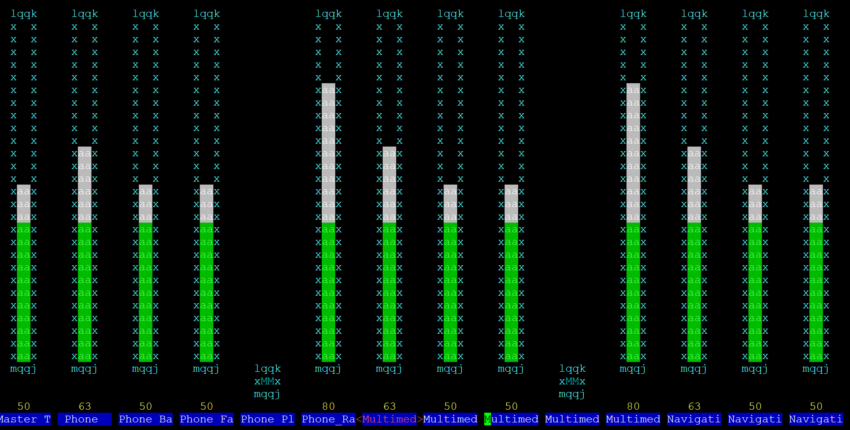
Result
Custom audio stream definitions
Configurable audio routing
Control Parameters using ALSA

Slide 11
Result
Custom audio stream definitions
Configurable audio routing
Control Parameters using ALSA
Advanced Tuning and DSP capabilities

Slide 12
Going Forward
Collaboration for reference mixer plugin
Release ADSP Driver/Interface

Slide 13
Questions?

